Slide 1
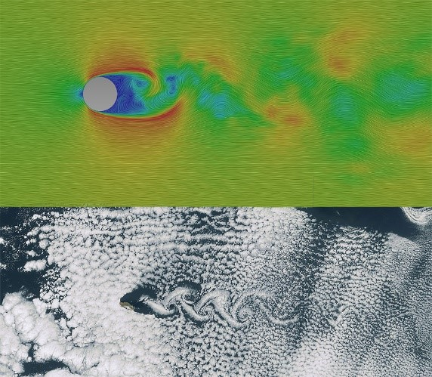
Application of Deep Learning to Computational Fluid Dynamics
Author: Jie Tao
Supervisor: Dr. Greg Wolffe

Slide 2
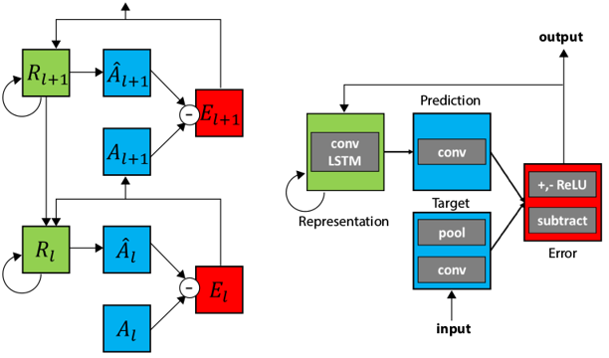
Background & Approach
1
3
Can we predict fluid flow by deep learning? Which is
Like video
Time series
Spatial
2
PredNet is a model used for video prediction achieved by ConvLSTM and encode-decode model. ConvLSTM allows multidimensional data coming with convolutional operations in each gate.
Fluid flow comes from left to right with velocity 1m/s.(OpenFOAM)

Slide 3
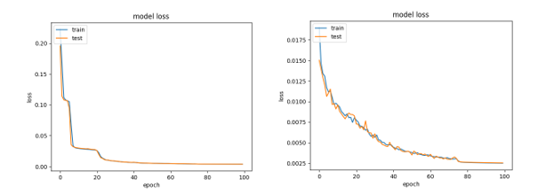
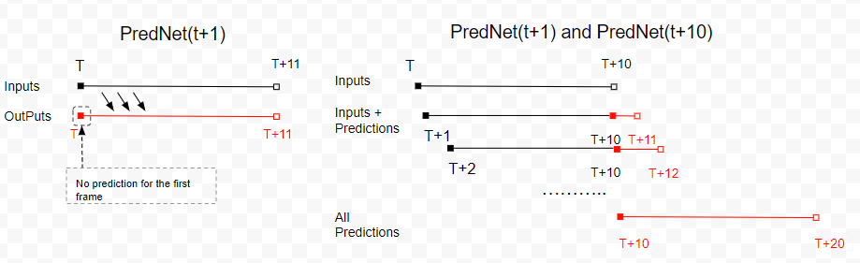
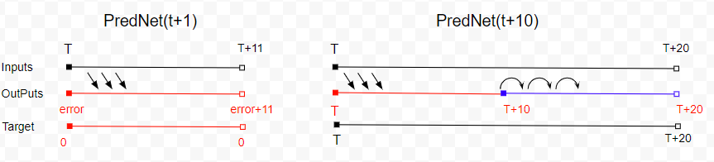
Implementation
6
4
Item | Specs
HPC Name: | Ghost
Processor | AMD Ryzen ThreadRipper 16-core liquid-cooled CPU
Memory | 64GB DDR4 3200MHz Corsair RAM
Hard Drive | 1 TB Samsung SSD; 2 TB Seagate HDD
GPU | NVIDIA Titan V w/51`20 cores (640 TensorCores), 12 GB GDDR5
OS | Ubuntu 18.04 LTS
Software | Keras (TensorFlow GPU), Python 3.6.7
Training and validation lose on Ghost: with Titan V GPU acceleration, the training time for 100 epochs and 7million parameters took 23 mins and 101 mins only on two models respectively.
We use Keras to train two PredNet models on Ghost with Titan V w/5120cores.
7
5
Three manners to do the predictions with two trained models.
Two models to be trained. One for t+1 prediction, another for t+10 prediction.

Slide 4
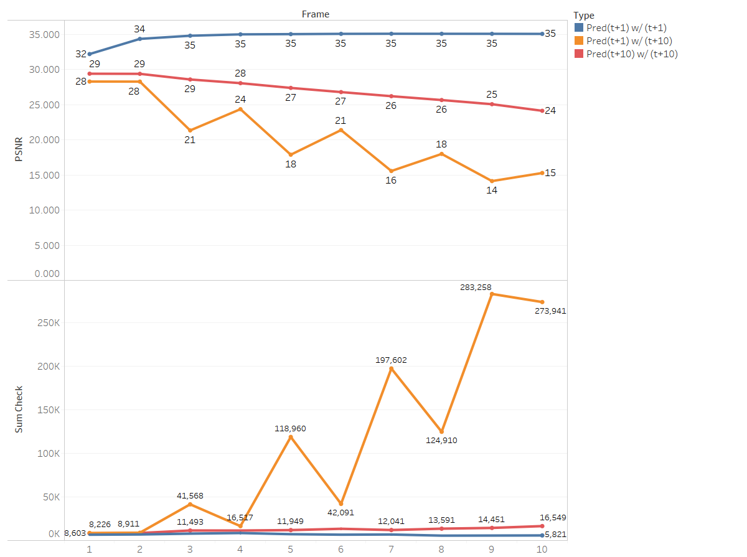
Validation & Conclusion
8
PredNet(t+1)w/(t+1)
PredNet(t+1)w/(t+10)
9
Conclusion:
DL works for CFD in the strictly controlled scenario.
We need more samples to adapt to more general situation.
PredNet(t+10)w/(t+10)
With extrapolation training, PredNet(t+10) can do relatively better performance in t+10 perdiction.

